Slide 1
Convolutional Neural Networks

Slide 2
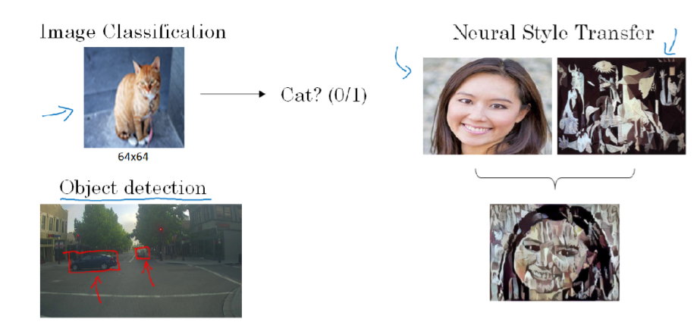
Computer Vision

Slide 3

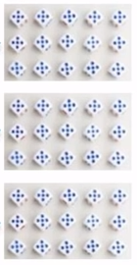
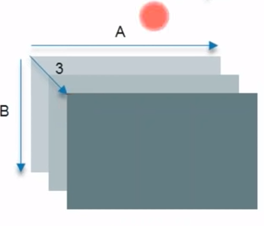
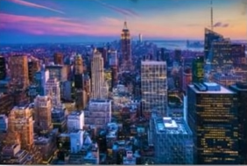
How a Computer Reads an Image
How a Computer sees an image
R
G
B
Pixel Values Of R,G,B

Slide 4
Why Not Fully Connected Networks

Slide 5
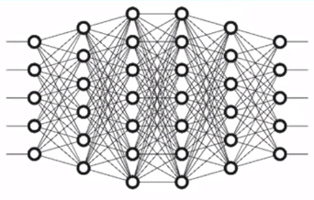
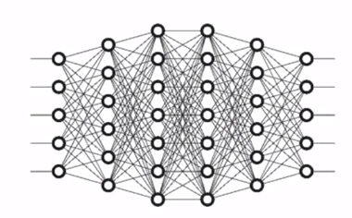
Why Not Fully Connected Networks
Image with 28 x 28 x3 Pixels
Number of weights in the first hidden layer will be 2352
Image with 200 x200 x 3 pixels
Number of weights in the first hidden layer will be 120,000

Slide 6

How CNN Works?

Slide 7
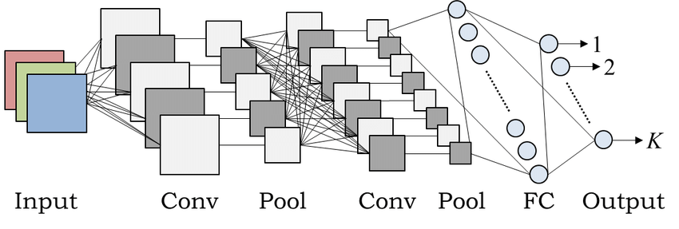

Slide 8
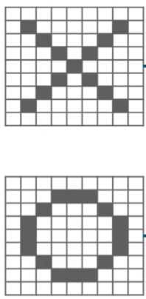
How CNN Works?
Convolutional Neural Networks Have Following Layers:
Convolution
ReLU Layer
Pooling
Fully Connected
X
CNN
0
CNN

Slide 9
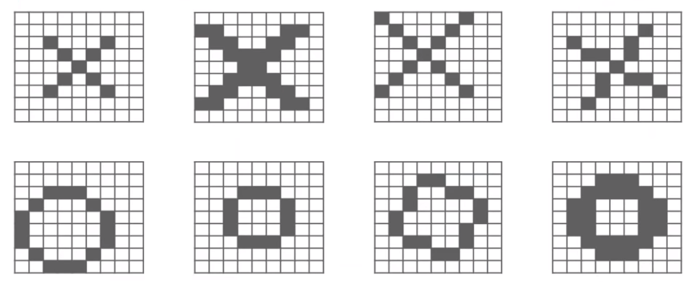
Trickier Case
Here, we will have some problems because X and 0 images won’t always have the same images. There can be certain deformations. Consider the diagrams show below:
X
0

Slide 10
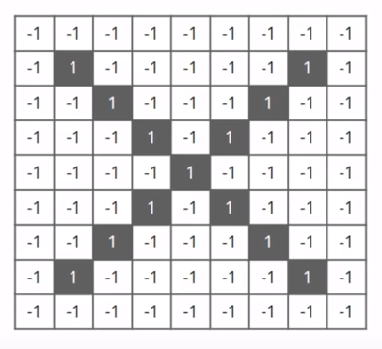
How CNN Works?
A Computer understands an image using numbers at each pixels.
In out example, we have considered that a black pixel will have a value of 1 and a white pixel will have -1 value.

Slide 11
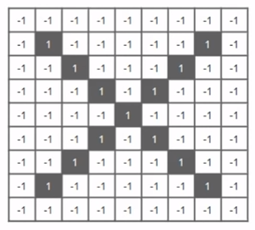
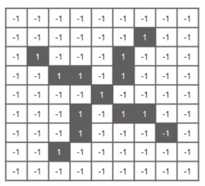
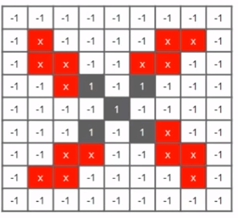
How CNN Works?
Using normal techniques, computers compare these images as:
+
=

Slide 12
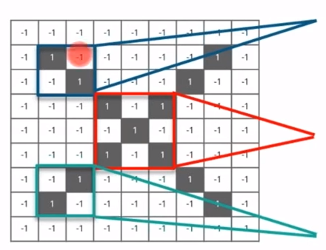
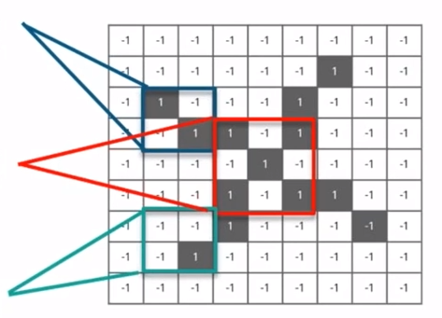
How CNN Works?
CNN Compares the images piece by piece. The pieces that it look for are called features .
By finding rough feature matches, in roughly the same position in two images, CNN gets a lot better at seeing similarity that whole-image schemes.
=
=
=

Slide 13
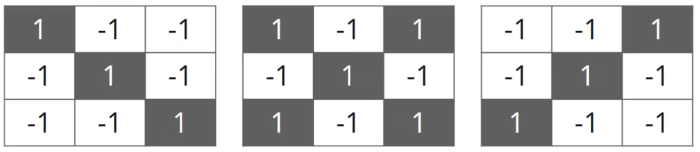
How CNN works?
We will be taking three features or filters, as shown below:

Slide 14
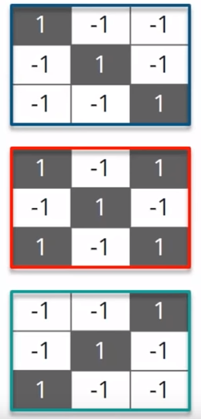
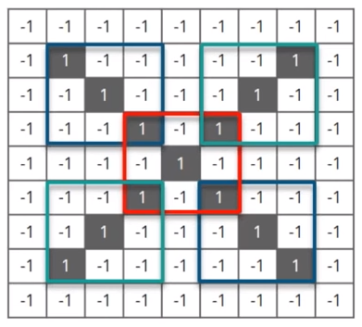
How CNN Works?
These are small pieces of the bigger image. We chose a feature and put it on the input image, if it matches then the image is classified correctly.

Slide 15
Convolution Layer

Slide 16
Steps involved in Convolution Layer
Here we will move the feature/filter to every possible position on the image.
Step - 1
Step - 2
Line up the feature and the image.
Multiply each image pixel by the corresponding feature pixel.

Slide 17
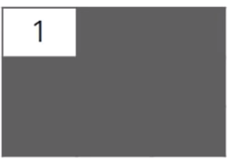
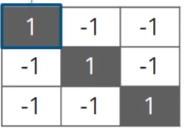
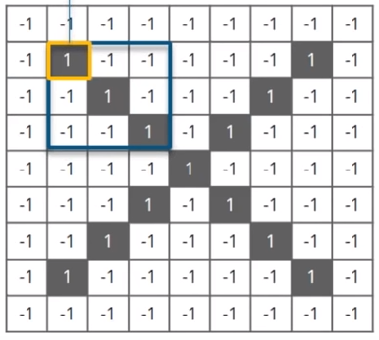
Multiplying the corresponding Pixel Values
1 x 1 = 1

Slide 18
Steps involved in Convolution Layer
Here we will move the feature/filter to every possible position on the image.
Step - 1
Step - 2
Line up the feature and the image.
Multiply each image pixel by the corresponding feature pixel.
Step - 3
Step - 4
Divide by total number of pixels in the feature.
Add Them Up.

Slide 19
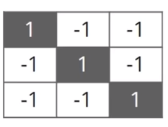
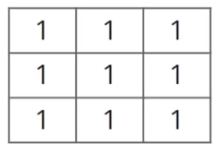
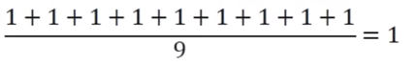
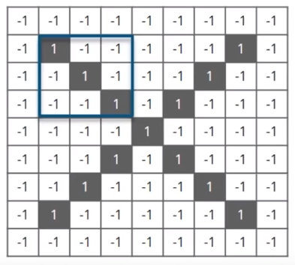
Adding And Dividing by the total numbers of Pixels

Slide 20
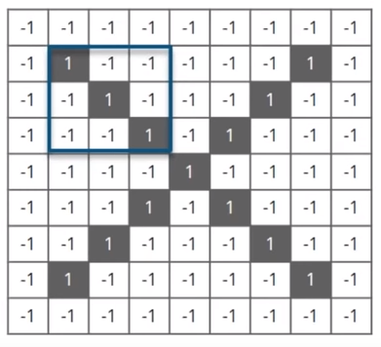
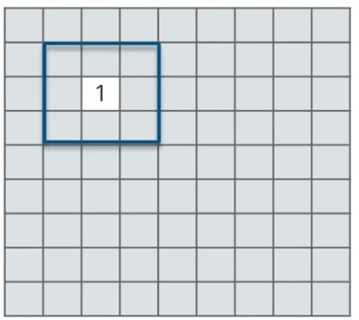
Creating a Map to put the value of the filter
Now to keep track of were that feature was, we create a map and put the values pf the filter at that place.

Slide 21
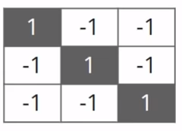
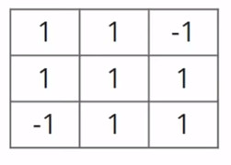
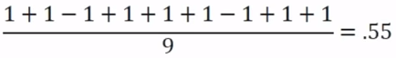
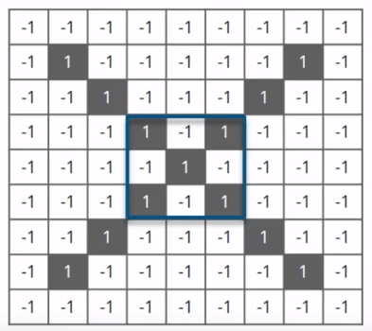
Sliding the filter Throughout the image
Now, using the same feature and move it to another location and perform the filtering again.

Slide 22
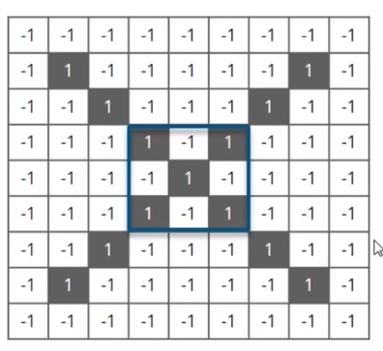
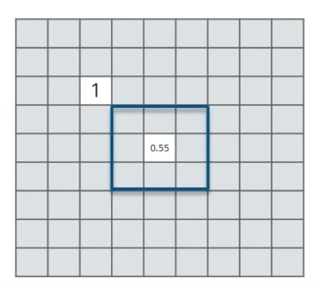
Convolution Layer
Now we will put the value of the filter at that position.

Slide 23
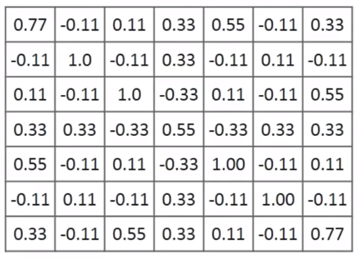
Convolution Layer Output
Similarly, we will move the feature to every other positions of the image and will see how the feature matcher that area. Finally we will get an output as:

Slide 24
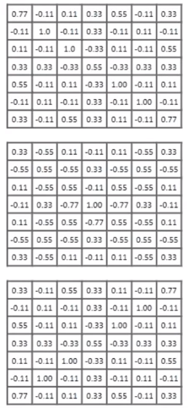

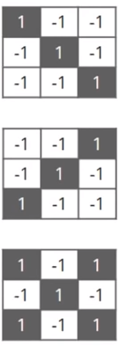
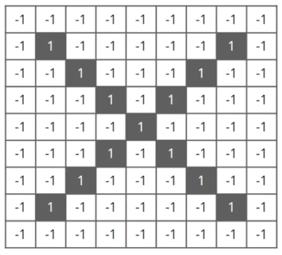
Convolution Layer output
Similarly, we will perform the same convolution with every other filters

Slide 25
ReLu Layer

Slide 26
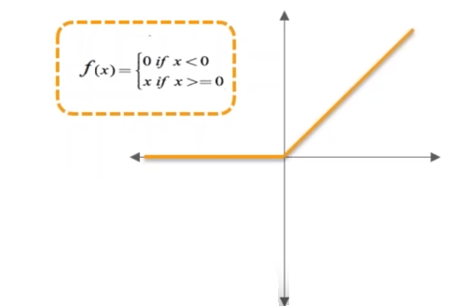
ReLU Layer
In this layer we remove every negative values from the filtered images and replaces it with zero’s.
This is done to avoid the values from summing up to zero.
Rectified Linear unit (ReLU) transform function only activates a node if the input is above a certain quantity, while the input is below zero, the input zero, but when the input rises above a certain threshold, it has a linear relationship with the dependent variable.
X | F(x)=x | F(x)
-3 | F(-3)=0 | 0
-5 | F(-5)=0 | 0
3 | F(3)=3 | 3
5 | F(5)=5 | 5

Slide 27
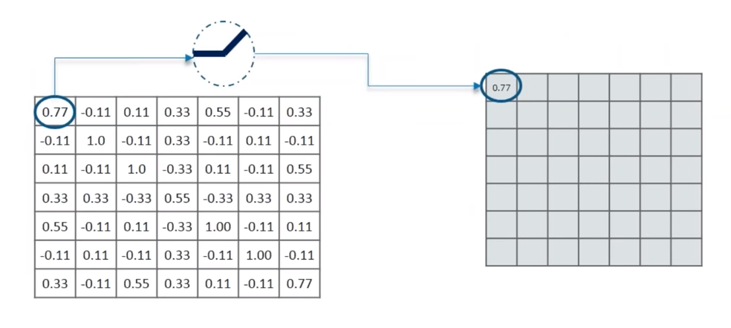
Removing Negative Values

Slide 28
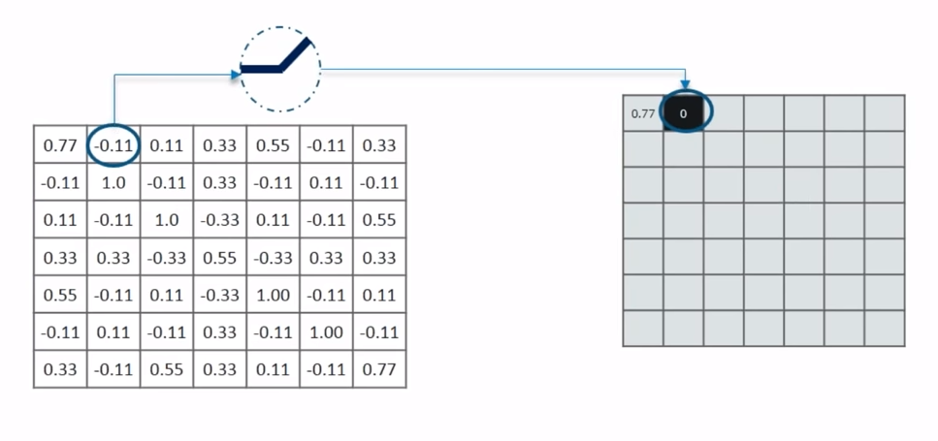
Removing Negative Values

Slide 29
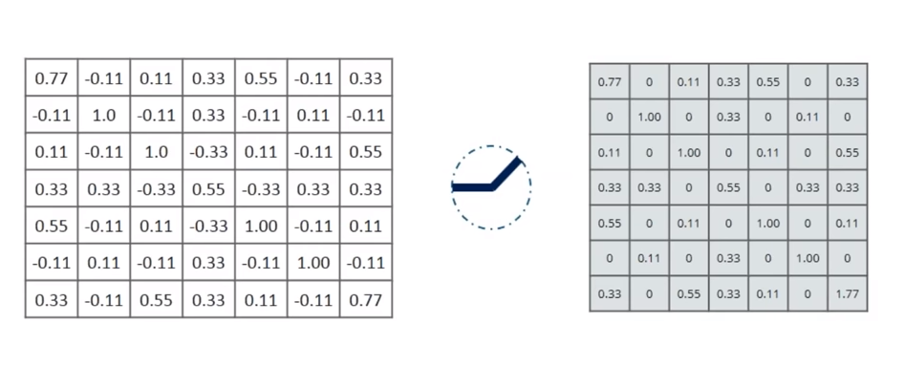
Output for one feature

Slide 30
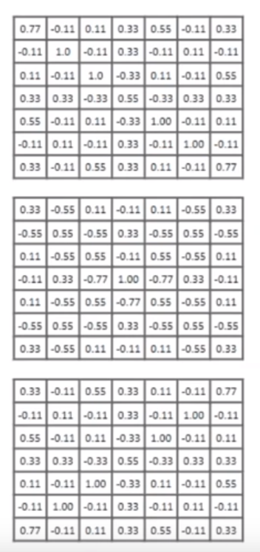
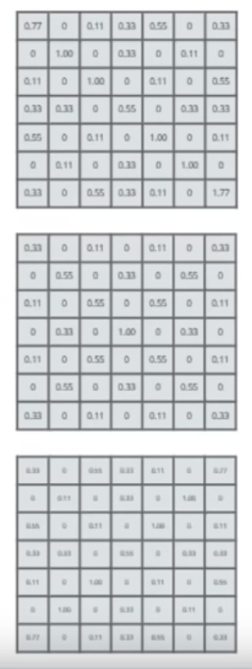

Output for All Features

Slide 31
Pooling Layer

Slide 32

Pooling Layer
In this we shrink the image stack into a smaller size steps:
Pick a window size (usually 2 or 3).
Pick a stride (usually 2)
Walk your windows across your filtered images.
From each window take the maximum value.

Slide 33
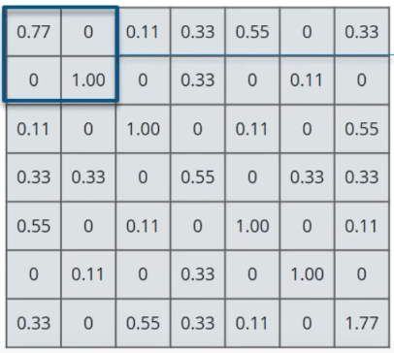
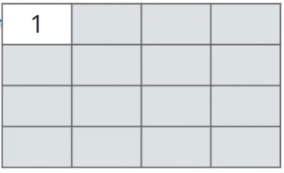
Calculating the maximum Value in each Window
Let’s start with our first filtered image
In our first window the maximum or highest value is 1, so we track that and move the window two strides.

Slide 34
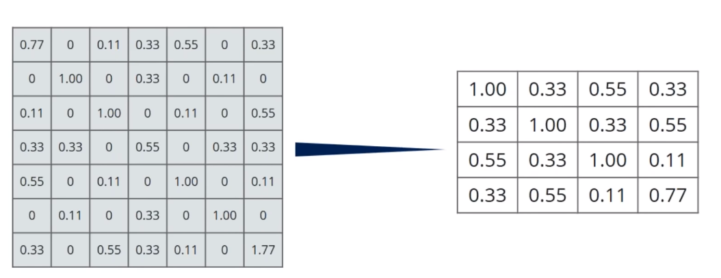
Moving the window Across the Entire Image

Slide 35
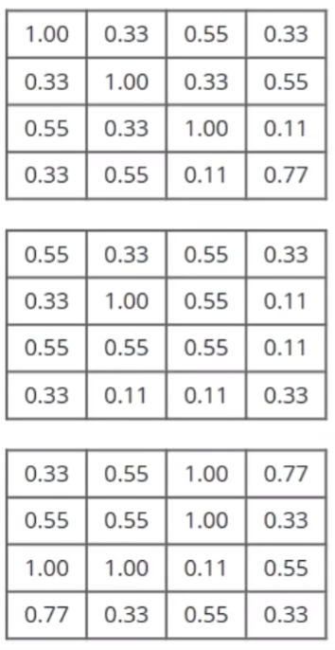
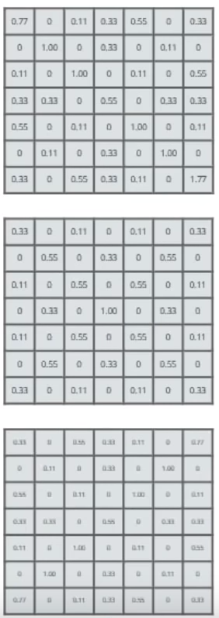

Output After Passing Through Pooling Layer

Slide 36
Stacking up the Layers

Slide 37
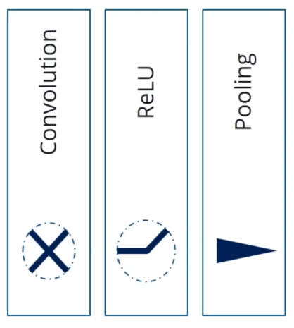
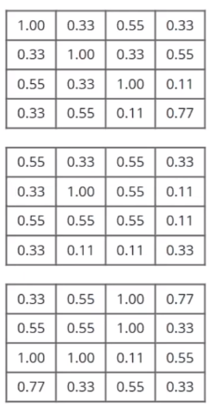

Stacking up the Layers

Slide 38



Stacking up the Layers

Slide 39

Fully Connected Layer
This is final layer where the actual classification happens
Here we take our filtered and shirked images and put them into a single list

Slide 40


Output
When we feed in, ‘X’ and ‘O’. Then there will be some element in the vector that will be high.
Consider the image below, as you can see for ‘X’ there are different element that high and similarly, for ‘O’ we have different elements that are high.

Slide 41

Prediction
Consider the below list of a new input image:

Slide 42
Prediction
Consider the below list of a new input image:
Let’s compare this with the list of ‘X’ and ‘0’

Slide 43


Comparing the input Vector with X
Sum
Sum
/
4.56
5
0.91
Input Image
Vector for ‘X’

Slide 44

Comparing the input Vector with o
Sum
Sum
/
2.07
4
0.51
Input Image
Vector for ‘0’

Slide 45


Result
.91
.51
The Input image is classified as ‘X’

Slide 46

CNN Implementation

Slide 47


Slide 48


Slide 49

Another CNN Implementation

Slide 50
Deep convolutional models: case studies
LeNet-5
AlexNet
ZFNet
VGG-16
ResNet

Slide 51
LeNet - 5
LeNet-5 (1998) was used on large scale to automatically classify hand-written digits on bank cheques in the United States.
By modern standards, LeNet-5 is a very simple network. It only has 7 layers, among which there are 3 convolutional layers (C1, C3 and C5), 2 sub-sampling (pooling) layers (S2 and S4), and 1 fully connected layer (F6), that are followed by the output layer.
Convolutional layers use 5 by 5 convolutions with stride 1. Sub-sampling layers are 2 by 2 average pooling layers.
Tanh and sigmoid activations are used throughout the network.

Slide 52
LeNet - 5
Individual convolutional kernels in the layer C3 do not use all of the features produced by the layer S2, which is very unusual by today’s standard. One reason for that is to made the network less computationally demanding. The other reason was to make convolutional kernels learn different patterns.
The output layer uses 10 Euclidean Radial Basis Function neurons that compute L2 distance between the input vector of dimension 84 and manually predefined weights vectors of the same dimension.
LeNet-5 was able to achieve error rate below 1% on the MNIST data set, which was very close to the state of the art at the time.

Slide 53


Slide 54
AlexNet
Before 2012, the only problem with CNNs was that they were hard to apply to high resolution images.
There needed to be an innovation that would be optimized for GPUs and cut down on training times while improving performance when training on millions of high res images.
AlexNet was the winning entry in ILSVRC 2012, a competition for image classification using the ImageNet Dataset.
ImageNet, is a dataset of over 15 millions labeled high-resolution images with around 22,000 categories. ILSVRC uses a subset of ImageNet of around 1000 images in each of 1000 categories. In all, there are roughly 1.3 million training images, 50,000 validation images and 100,000 testing images.

Slide 55
AlexNet
The input to AlexNet is an RGB image of size 256×256. This means all images in the training set and all test images need to be of size 256×256.
If the input image is not 256×256, it needs to be converted to 256×256 before using it for training the network.
The architecture consists of eight layers: five convolutional layers and three fully-connected layers.
AlexNet uses Rectified Linear Units (ReLU) instead of the tanh function, which was standard at the time.

Slide 56
AlexNet
AlexNet allows for multi-GPU training by putting half of the model’s neurons on one GPU and the other half on another GPU. Not only does this mean that a bigger model can be trained, but it also cuts down on the training time.
CNNs traditionally “pool” outputs of neighboring groups of neurons with no overlapping. However, when the AlexNet authors introduced overlap, they saw a reduction in error by about 0.5% and found that models with overlapping pooling generally find it harder to overfit.
Two methods were employed to reduce overfitting: Data Augmentation and Dropout

Slide 57


Slide 58
ZFNet
ZFNet is the winner of the ILSVRC (ImageNet Large Scale Visual Recognition Competition) 2013.
Overall, the architecture of the network is an optimized version of the last year’s winner – AlexNet
The authors spent some time to find out the bottlenecks of AlexNet and removing them, achieving superior performance.
In particular, they reduced filter size in the first convolutional layer from 11x11 to 7x7, which resulted in fewer dead features learned in the first layer. A dead feature is a situation where a convolutional kernel fails to learn any significant representation.

Slide 59
ZFNet
In addition to changing the filter size, the authors of ZFNet have doubled the number of filters in all convolutional layers and the number of neurons in the fully connected layers as compared to the AlexNet.
Besides, the ZFNet paper introduced a way to visualize learned convolutional features. Before this work, convolutional neural networks were pretty much black boxes, whose internal workings were unknown. This paper offered essential insights into how convolutional neural networks are learning internal representations.
The Deconvnet is a slightly modified backward pass through a convnet that you are trying to visualize.
To summarize, it was not a revolutionary change, but rather evolutionary, building upon the ideas of the previous year’s winner.

Slide 60
ZFNet
A separate Deconvnet is attached to the output of each layer whose features we want to visualize.
Each Deconvnet itself is a neural network whose input is activations of a particular layer, and the output is an image depicting pixels that are responsible for maximum activation of a convolutional kernel of our interest for a given convolutional layer.
In the paper, Deconvnet is described as a sequence of transposed convolutions, de-pooling and a special modified ReLU.
The sequence of operations is the reverse of the steps that were used in the original neural network to produce a particular layer’s output.

Slide 61


Slide 62
VGG-16
VGG16 is a convolution neural net (CNN ) architecture which was used to win ILSVRC(Imagenet) competition in 2014.
In VGG-16, there are 13 convolutional layers, 5 Max Pooling layers and 3 Dense layers which sums up to 21 layers but only 16 weight layers.
VGG-16 network is trained on ImageNet dataset which has over 14 million images and 1000 classes, and acheives 92.7% top-5 accuracy. It surpasses AlexNet network by replacing large filters of size 11 and 5 in the first and second convolution layers with small size 3x3 filters.
Conv 1-1 and 1-2 has number of filters as 64 while Conv 2-1 and 2-2 has 128 filters, Conv 3-1,3-2,3-3 has 256 filters while Conv 4-1,4-2,4-3 and Conv 5-1,5-2,5-3 has 512 filters.

Slide 63
VGG-16
Most unique thing about VGG16 is that instead of having a large number of hyper-parameter the authors focused on having convolution layers of 3x3 filter with a stride 1 and always used same padding and maxpool layer of 2x2 filter of stride 2.
It follows this arrangement of convolution and max pool layers consistently throughout the whole architecture.
This network is a pretty large network and it has about 138 million (approx) parameters.

Slide 64


Slide 65
ResNet
Unlike traditional sequential network architectures such as AlexNet, OverFeat, and VGG, ResNet is instead a form of “exotic architecture” that relies on micro-architecture modules (also called “network-in-network architectures”).
The term micro-architecture refers to the set of “building blocks” used to construct the network. A collection of micro-architecture building blocks (along with your standard CONV, POOL, etc. layers) leads to the macro-architecture (i.e,. the end network itself).

Slide 66
ResNet
More layers is better but because of the vanishing gradient problem, model weights of the first layers can not be updated correctly through the backpropagation of the error gradient (the chain rule multiplies error gradient values lower than one and then, when the gradient error comes to the first layers, its value goes to zero).
That is the objective of Resnet : preserve the gradient.
A residual is the error in a result.
Let’s say, you are asked to predict the age of a person, just by looking at her. If her actual age is 20, and you predict 18, you are off by 2. 2 is our residual here. In essence, Actual = Prediction + Residual.

Slide 67

ResNet
So we want a deeper network where:
We want to go deeper without degradation in accuracy and error rate. We can do this via injecting identity mappings.
We want to be able to learn the residuals so that our predictions are close to the actuals. This is realized by ResNet with shortcut connections.
Shortcut connections are those skipping one or more layers. In our case, the shortcut connections simply perform identity mapping, and their outputs are added to the outputs of the stacked layers.

Slide 68


Slide 69


Slide 70

Data augmentation

Slide 71


Slide 72

Object detection

Slide 73


Slide 74


Slide 75


